Slide 1

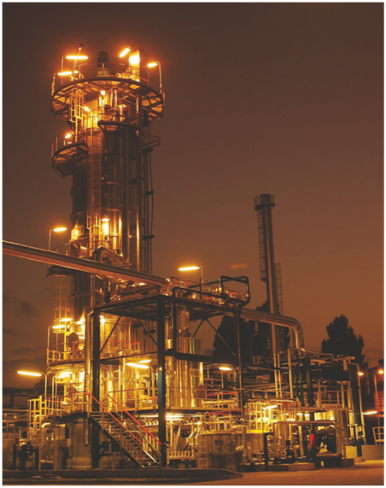
OMNIPOTENT
Industries Pvt.Ltd.
IMPORTERS & SUPPLIERS of BITUMEN & BITUMINOUS PRODUCTS.
IMPORTED, HANDLED, INDENTING & TRADING of 51,224 MT BITUMEN IN LAST BUSINESS YEAR
“Omnipotent Industries Pvt. Ltd.”, was the proud sponsor as lunch host for the event AME Conference 2019 held on 21st –22nd August 2019 at Sahara Star Hotel Mumbai.

Slide 2


With focus on new ideas & innovation in Bitumen Industry The Omnipotent Industries Pvt Ltd. was established in Mumbai in 2016 to carry on the existing bitumen business of Global Enterprises & it’s Organization. The group has vast experience & expertise of more than 19 years in Bitumen industry headed by Mr. Prince P. Shah - Founder & Managing Director of Omnipotent Industries Pvt. Ltd. & transitioned Global enterprises a proprietory firm into Omnipotent - A Team single handedly looking into all dimensions of Bitumen business with dedicated expertise.
Omnipotent is the Customer oriented organization. The company is working for reliability & is incubating exciting business models & proposals to it’s customers. Our branches have tie-ups with manufacturing company for job work & supply of Bituminous products.
Our Branches & JV’s at : Mumbai, Delhi, Ahmedabad, Chennai, Bangalore, Indore, Ernakulam, Hyderabad, Mangalore, Kolkata.
OUR JVS & JOB WORK LOCATIONS :
Bulk Bitumen Imported at :
Gujrat – Mundra
Gujrat – Pipavav
Maharashtra – Mumbai
Maharashtra – Dighi
Karnataka – Karwar
Karnataka – Mangalore
Drum Bitumen Imported at :
Gujrat – Mundra
Maharashtra – Mumbai
Karnataka – Mangalore
Tamilnadu – Chennai
PSU Bulk Bitumen from :
Gujrat – Vadodara
Maharashtra – Mumbai
Karnataka – Mangalore
Tamilnadu – Chennai
Telangana – Vishakhapattanam
Other Bituminous Products :
Karnataka – Belgum, Mangalore
Maharashtra – Mumbai, Nagpur
Telangana – Hyderabad
Gujrat – Baroda, Kutch
REGISTERED OFFICE :
Address : 1/11 Damji Nenshi Estate,
Station Road, Bhandup (West),
Mumbai – 400078.
Maharashtra, India.
Mobile No : +91 7400152424/ 9448281224
Telephone No : 022 21670182/183/184
Email : info@omnipotent.co.in
Website : www.omnipotent.co.in
www.princeshah.com
CIN No.: U74999MH2016PTC285902

Slide 3

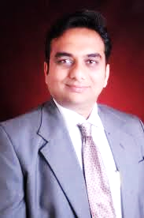
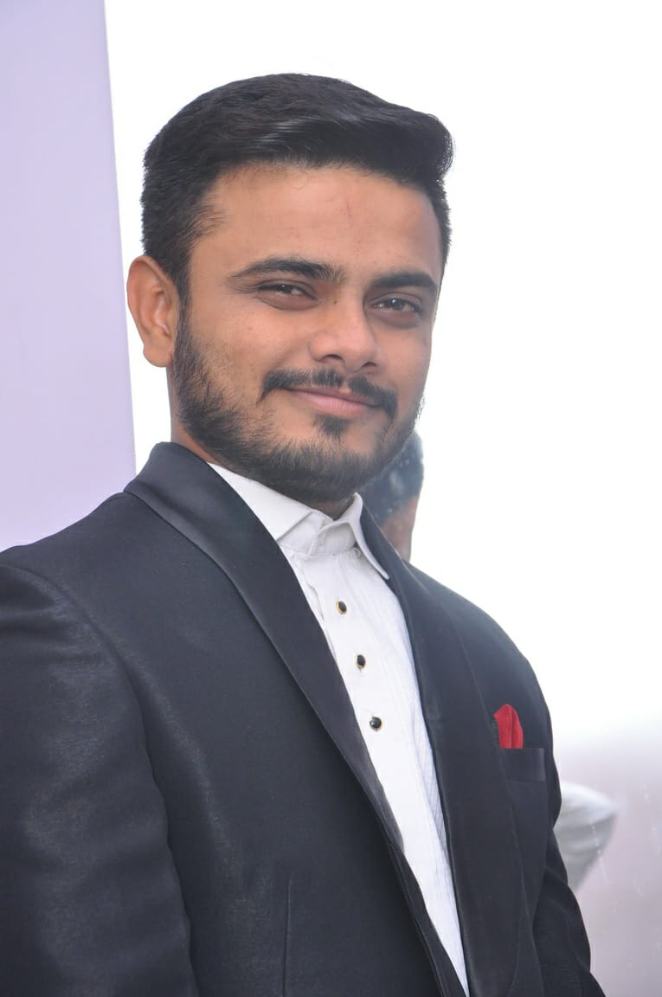


Professional experience :
Founder & MD of Omnipotent Industries Pvt.Ltd.
Founder & CEO at Krushstar Industry Pvt.Ltd.
General Manager at TikiTar Industry Baroda Pvt.Ltd. (South India)
General Manager at Southern Asphalt (Karnataka).
*MBA in Marketing & Finance
Mobile: +91 7795242424
E-Mail: princepshah@gmail.com
prince.omnipotent@gmail.com
Website: www.princeshah.com
www.omnipotent.co.in
Prince Shah
Managing Director
The personal &professional history of Mr. Prince Shah can be traced along the same path as the Omnipotent & Global Enterprises group, a organization that he has nurtured, grown and developed under his leadership for over 19 years.
Driven by a strong passion to be a successful entrepreneur, Punit is a biotechnology engineer from VVP Engineering College (2005-09 Batch) and has been associated with distinct successful ventures in the areas of bio-services and engineering education.
Punit Popat
CEO of the company
Punit has served as a founding member and executive director at various startups. With an objective to fast-pace already successful entrepreneurship career, Punit Popat joined hands with Mr. Prince P. Shah and Omnipotent in 2017, since then team has never looked back & together have scaled many milestones with the help of strong and dedicated passion driven team.
* Biotechnology Engineer
Mobile: +91 7795242424,
E-Mail: punit.omnipotent@gmail.com
Website: www.omnipotent.co.in
“ WINNERS DON’T DO DIFFERENT THINGS,
THEY DO THINGS DIFFERENTLY ! ”

Slide 4

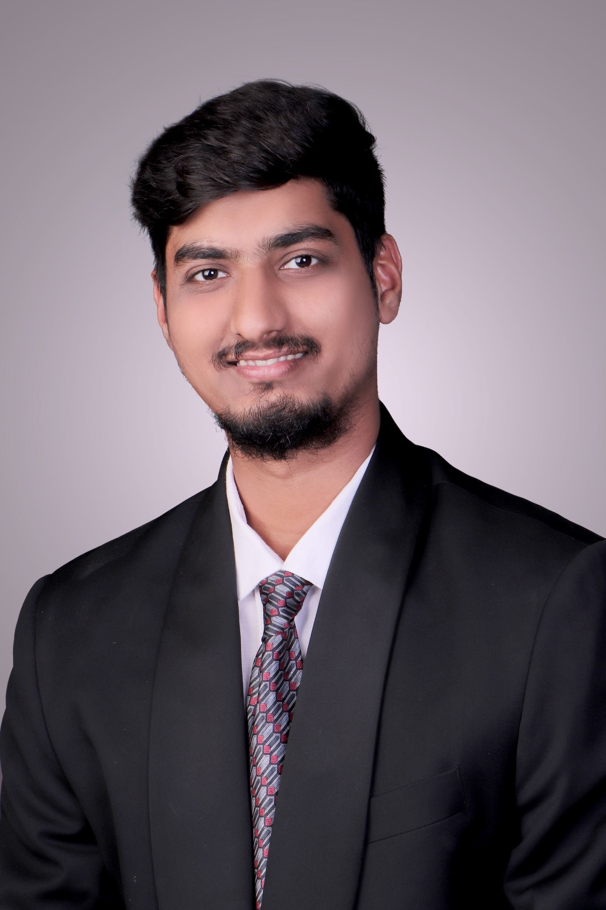
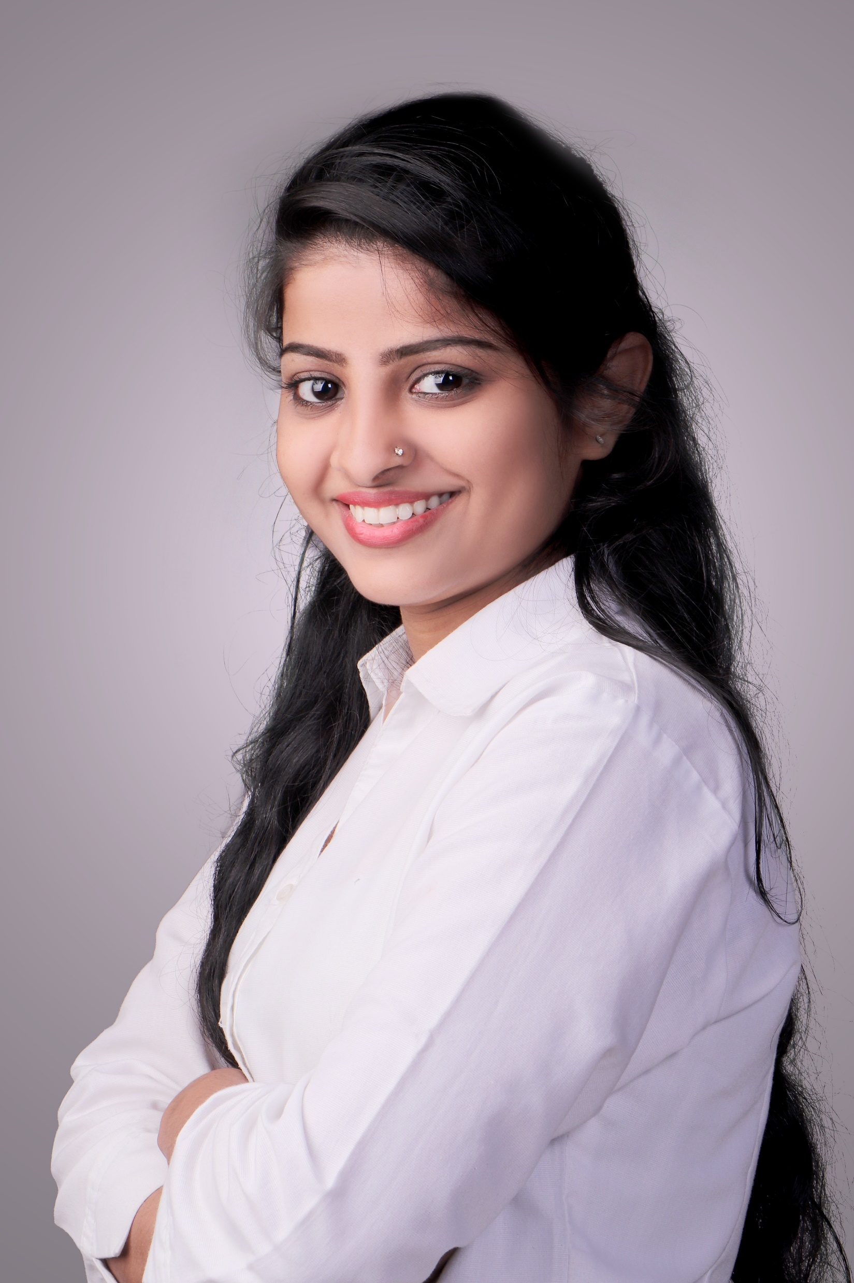
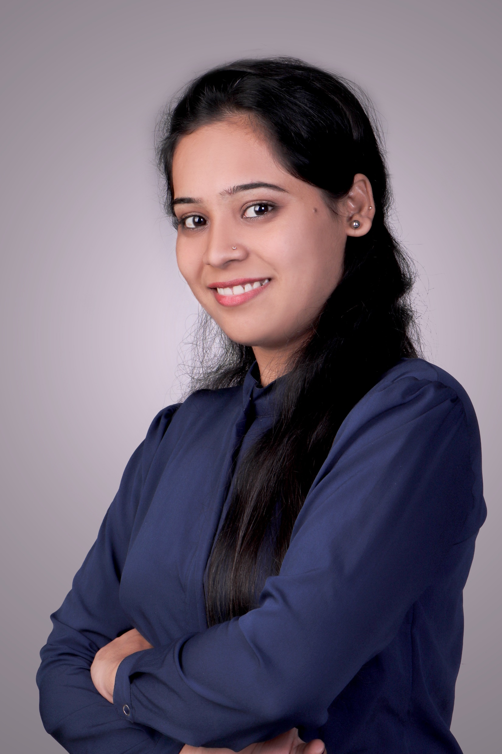
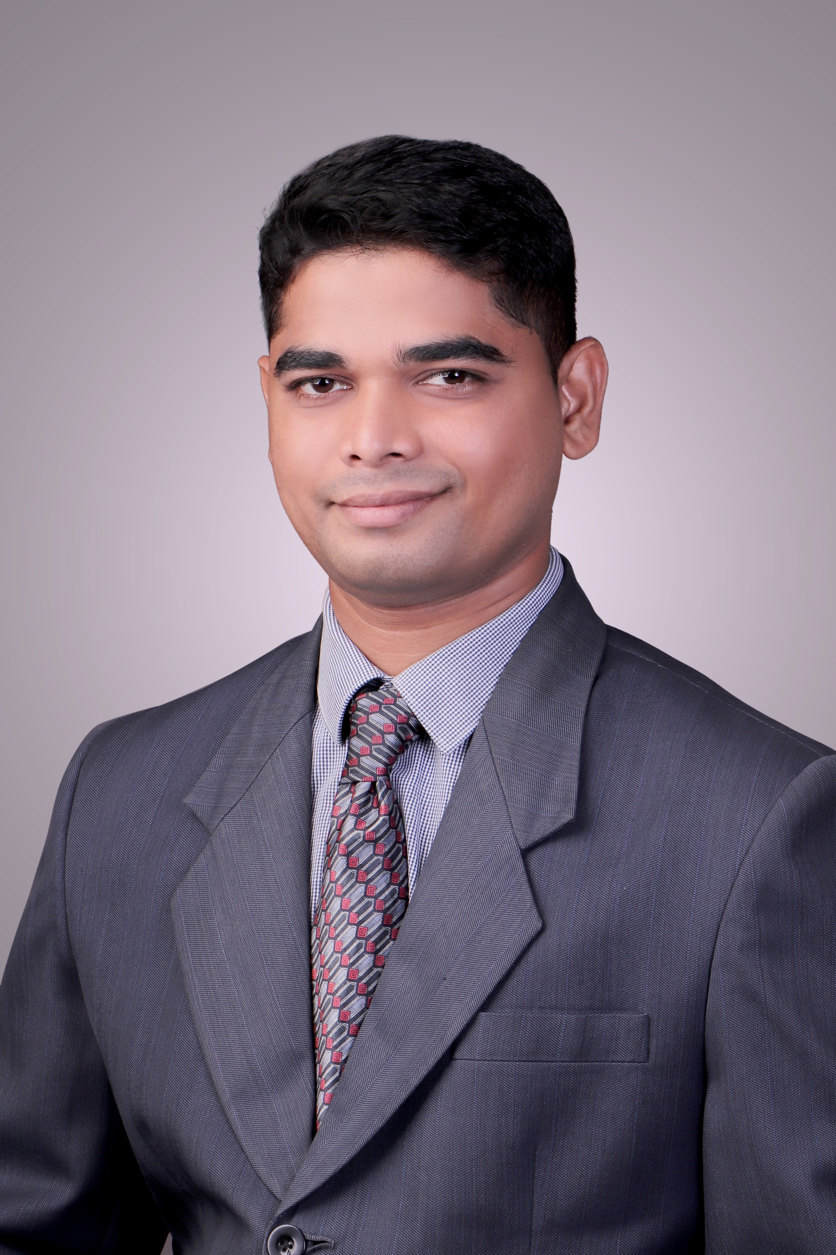
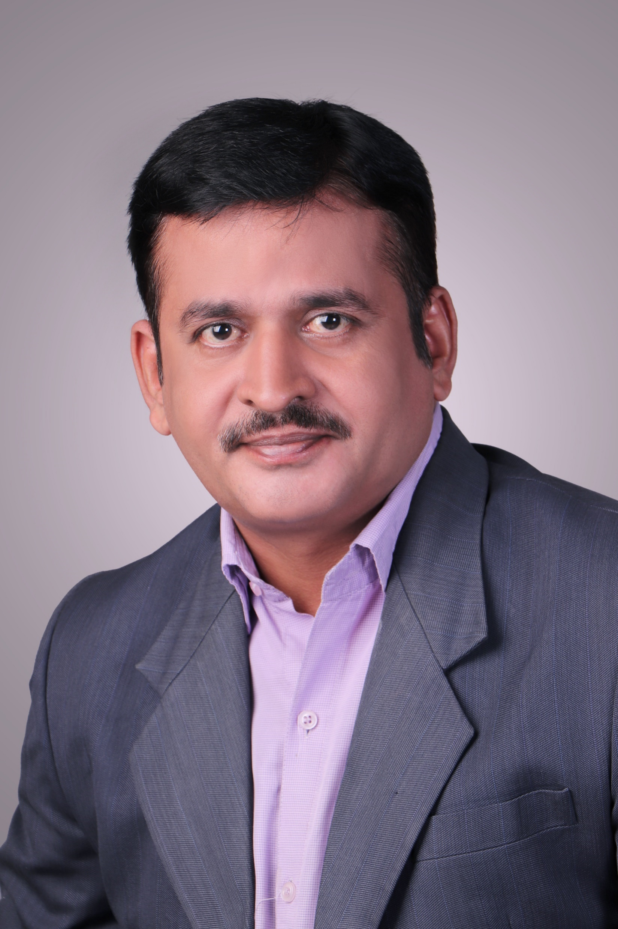
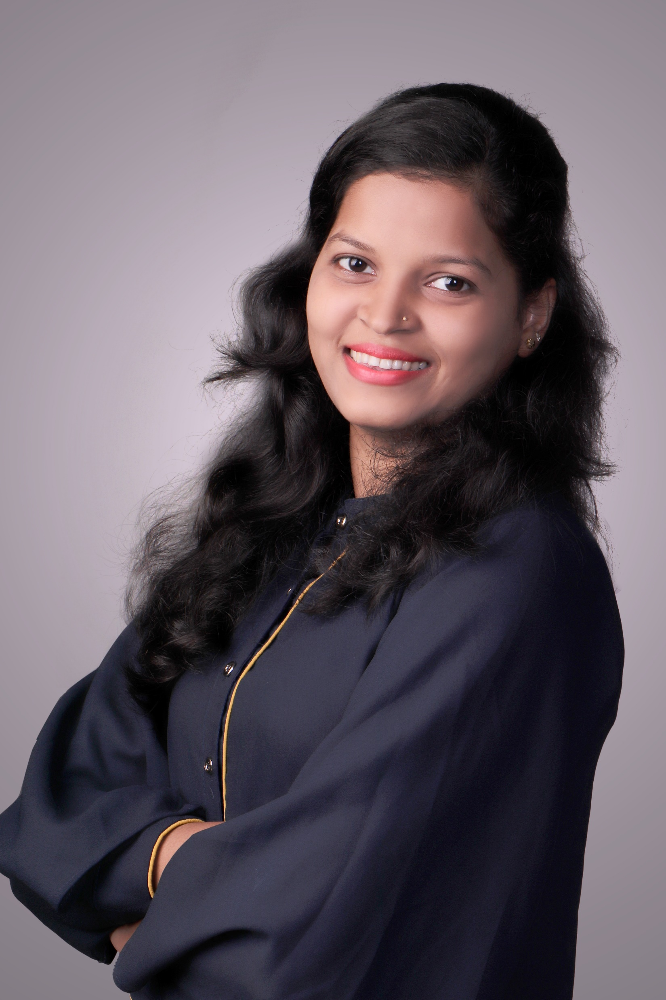
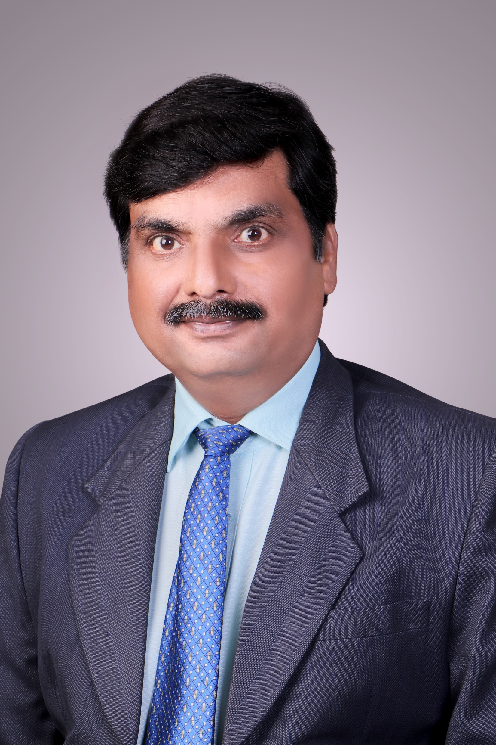
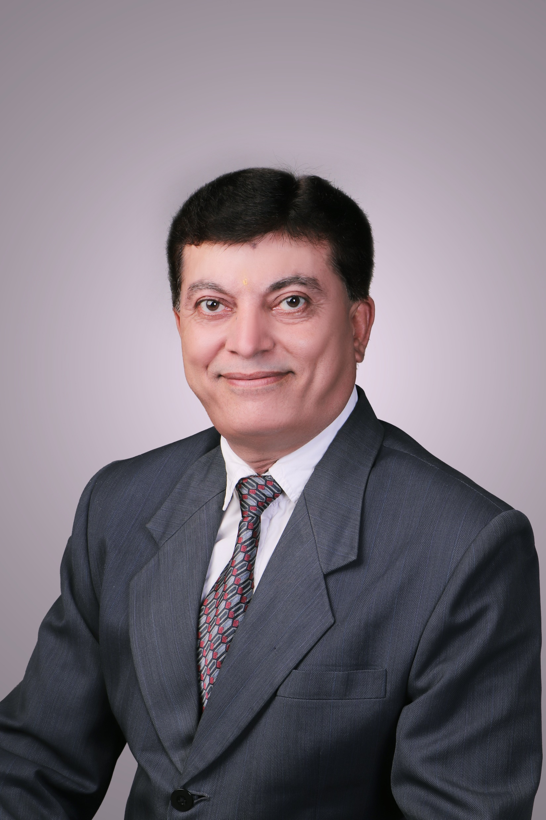
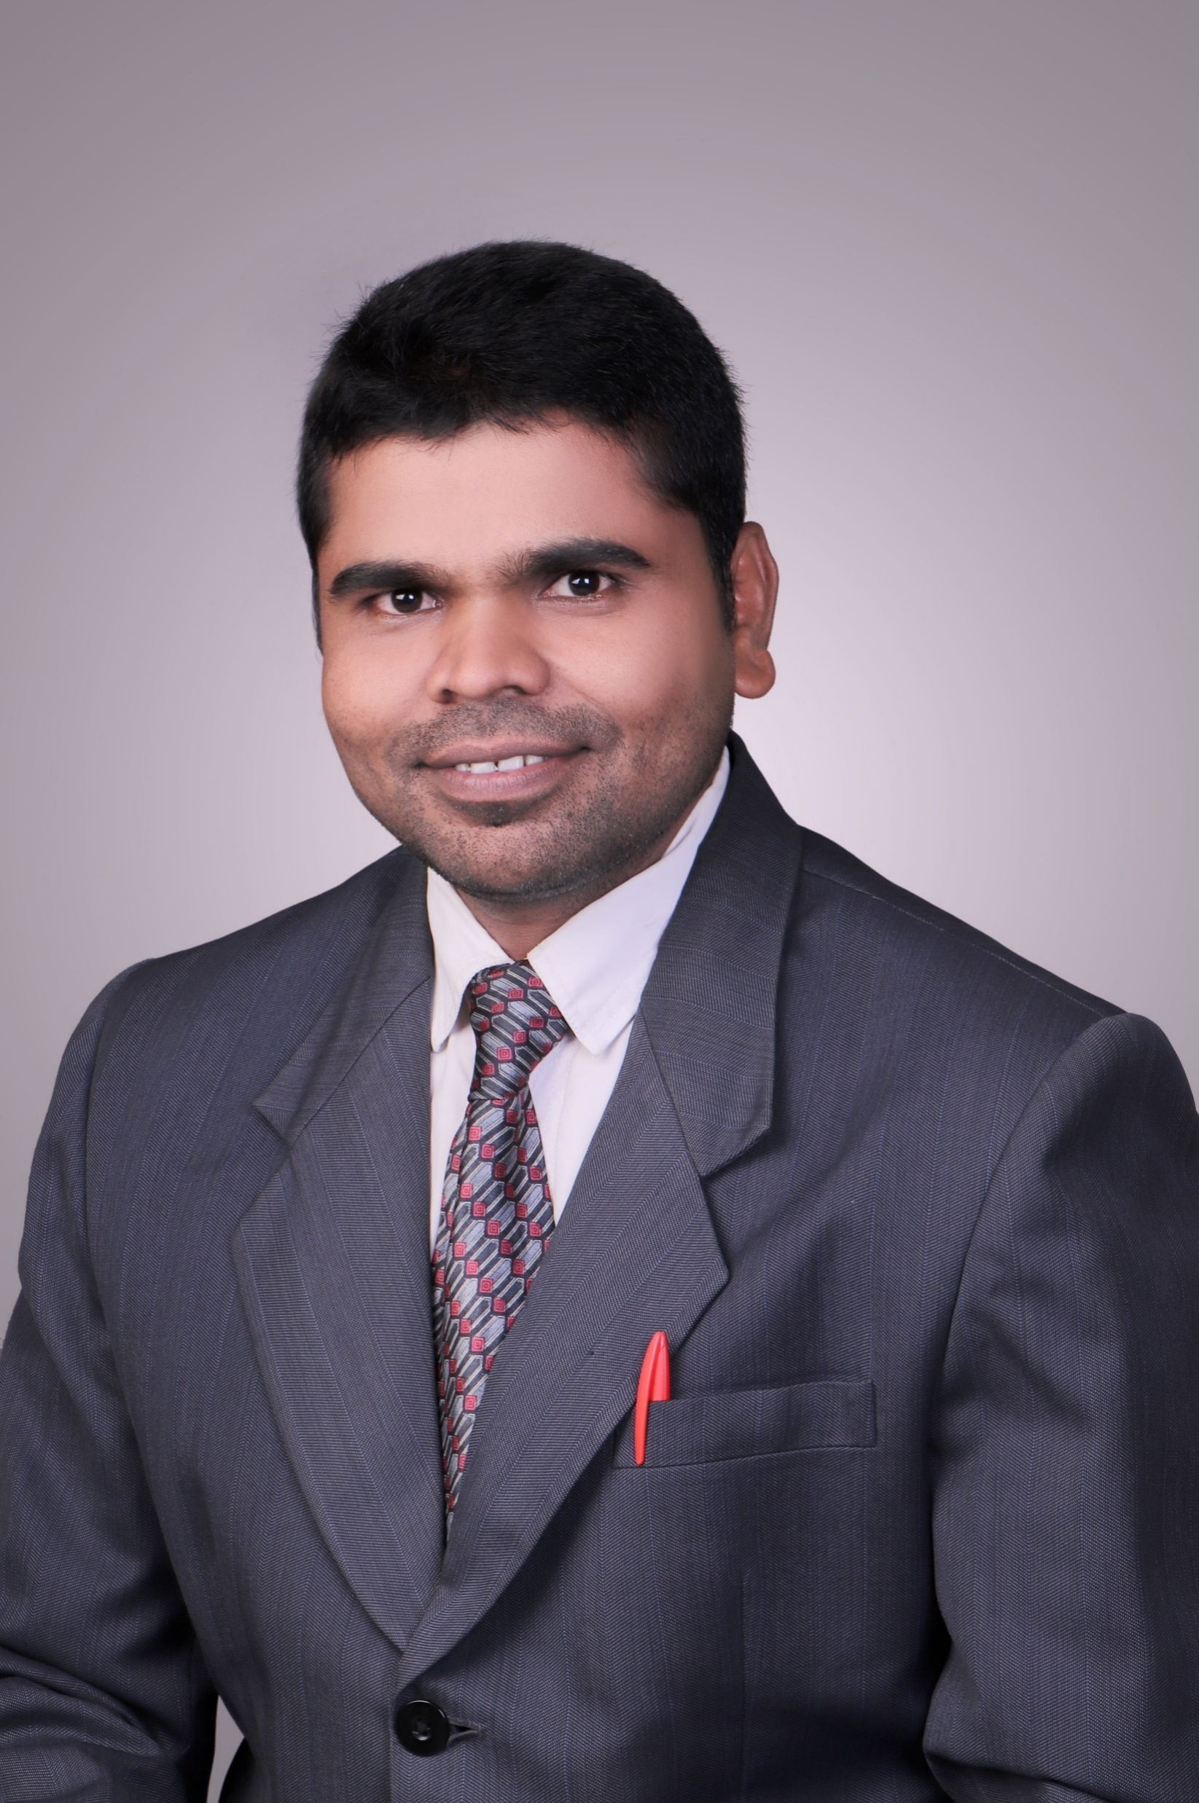
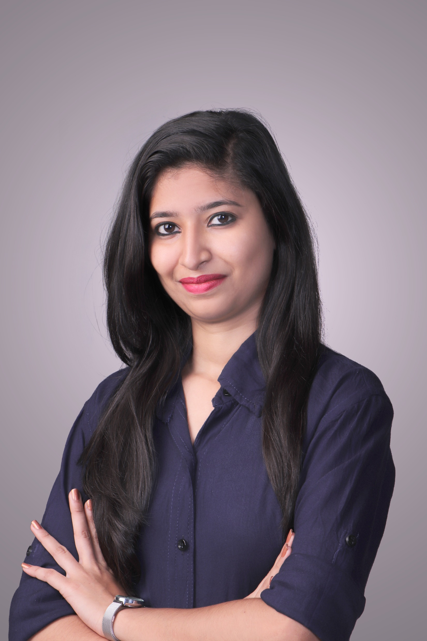
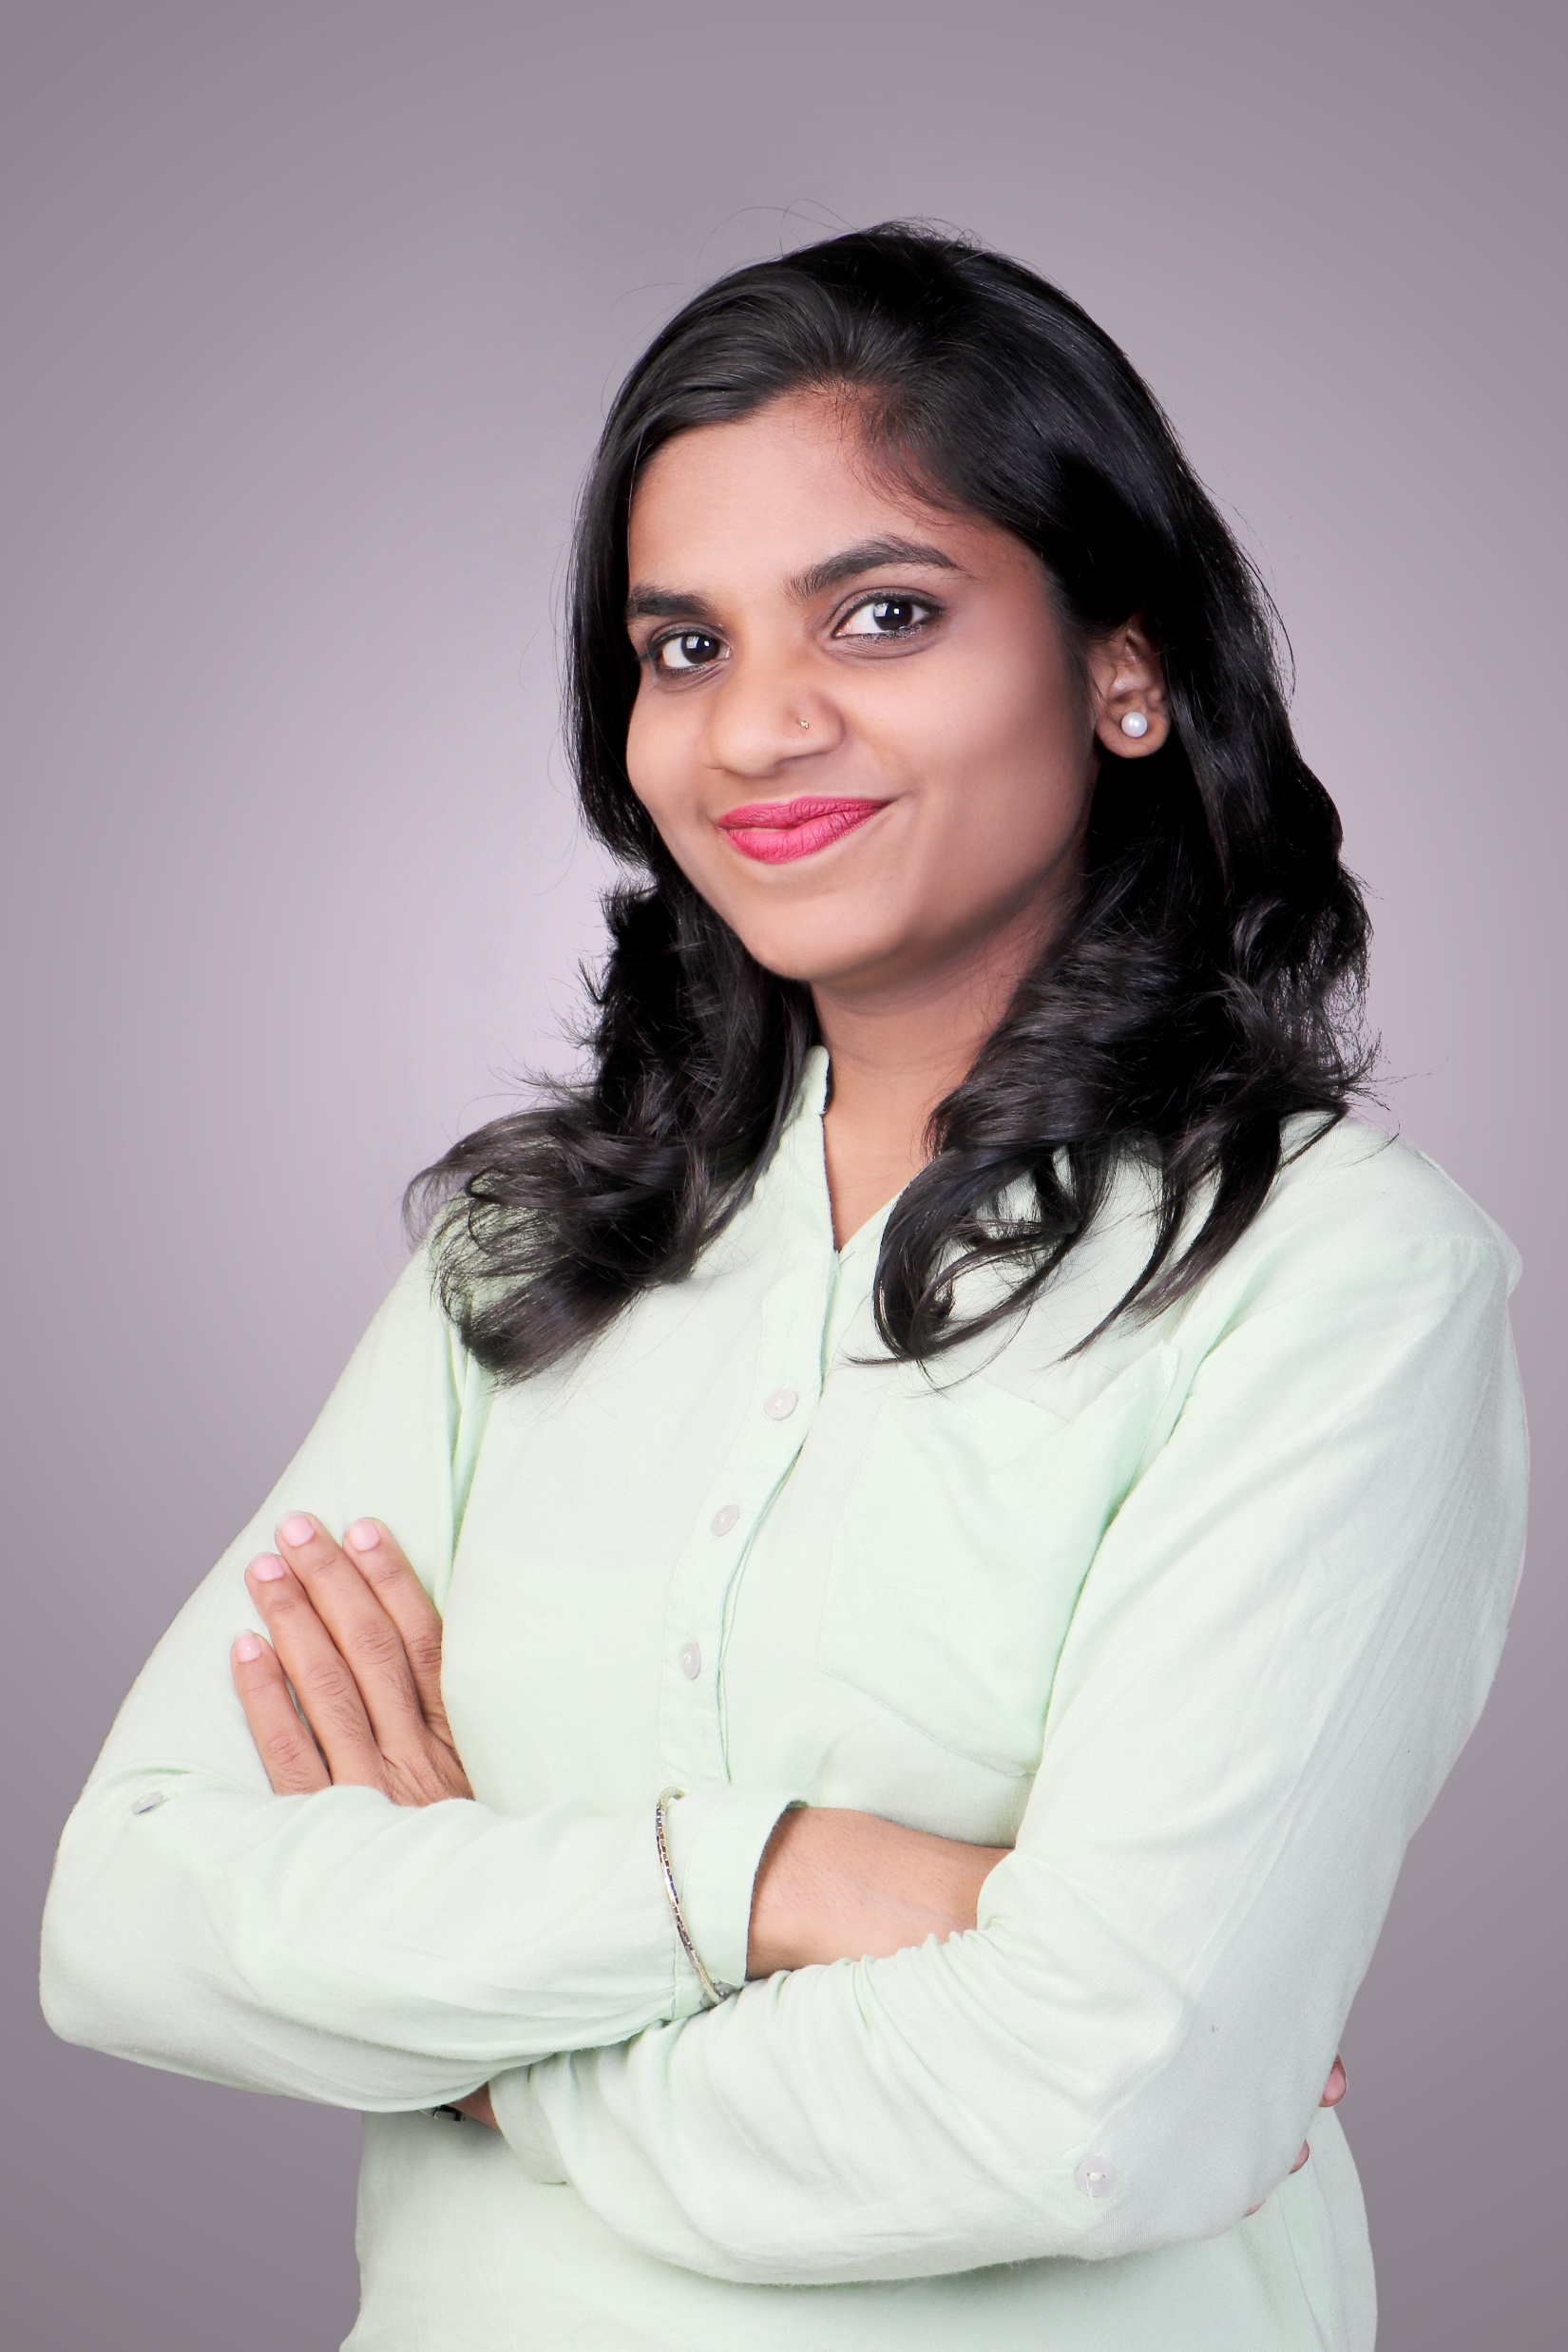
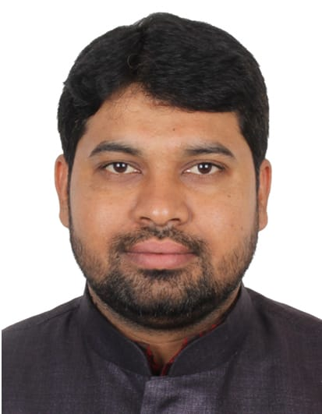
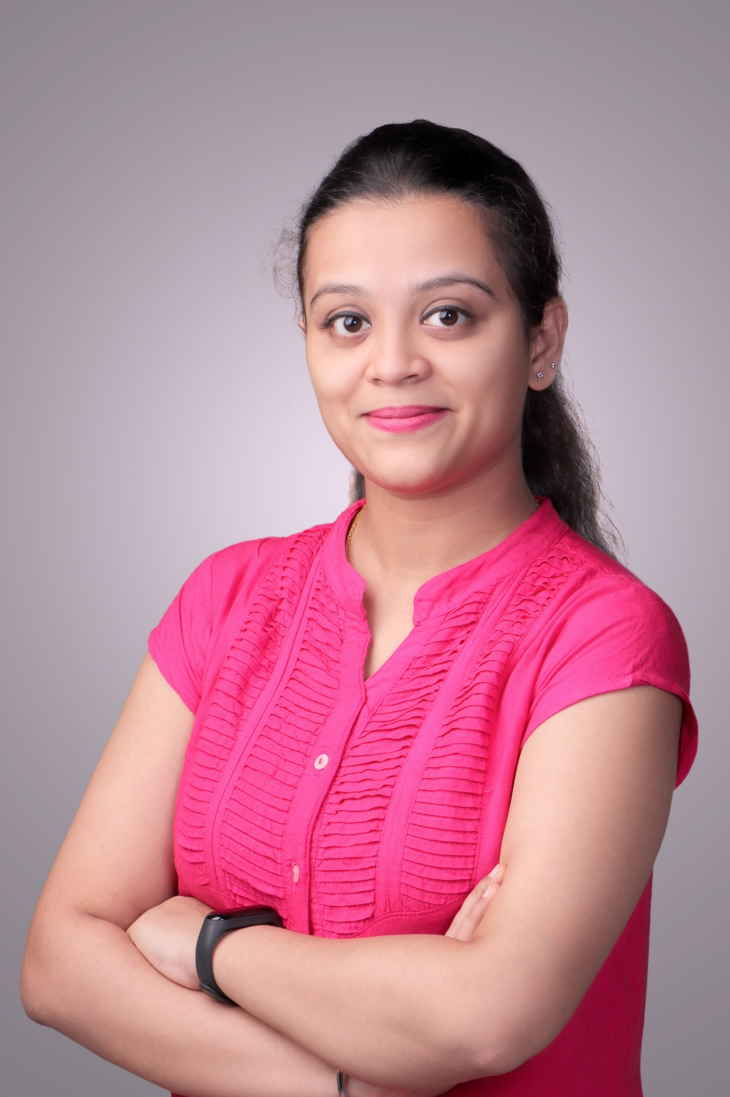
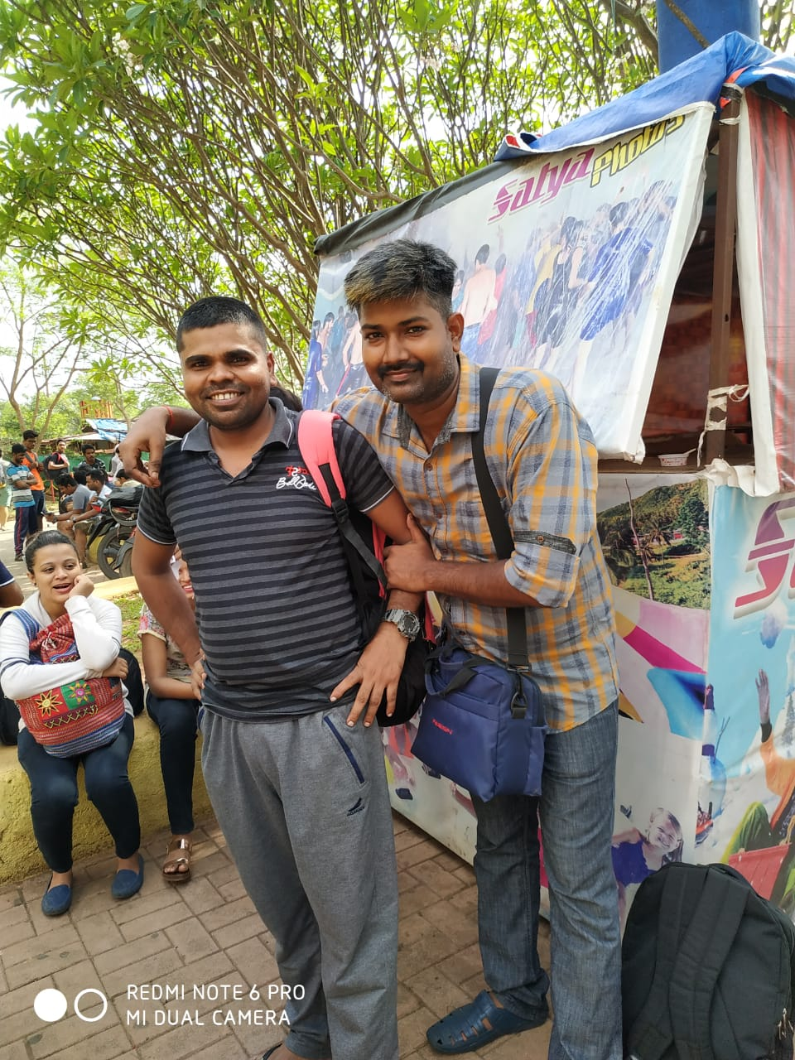
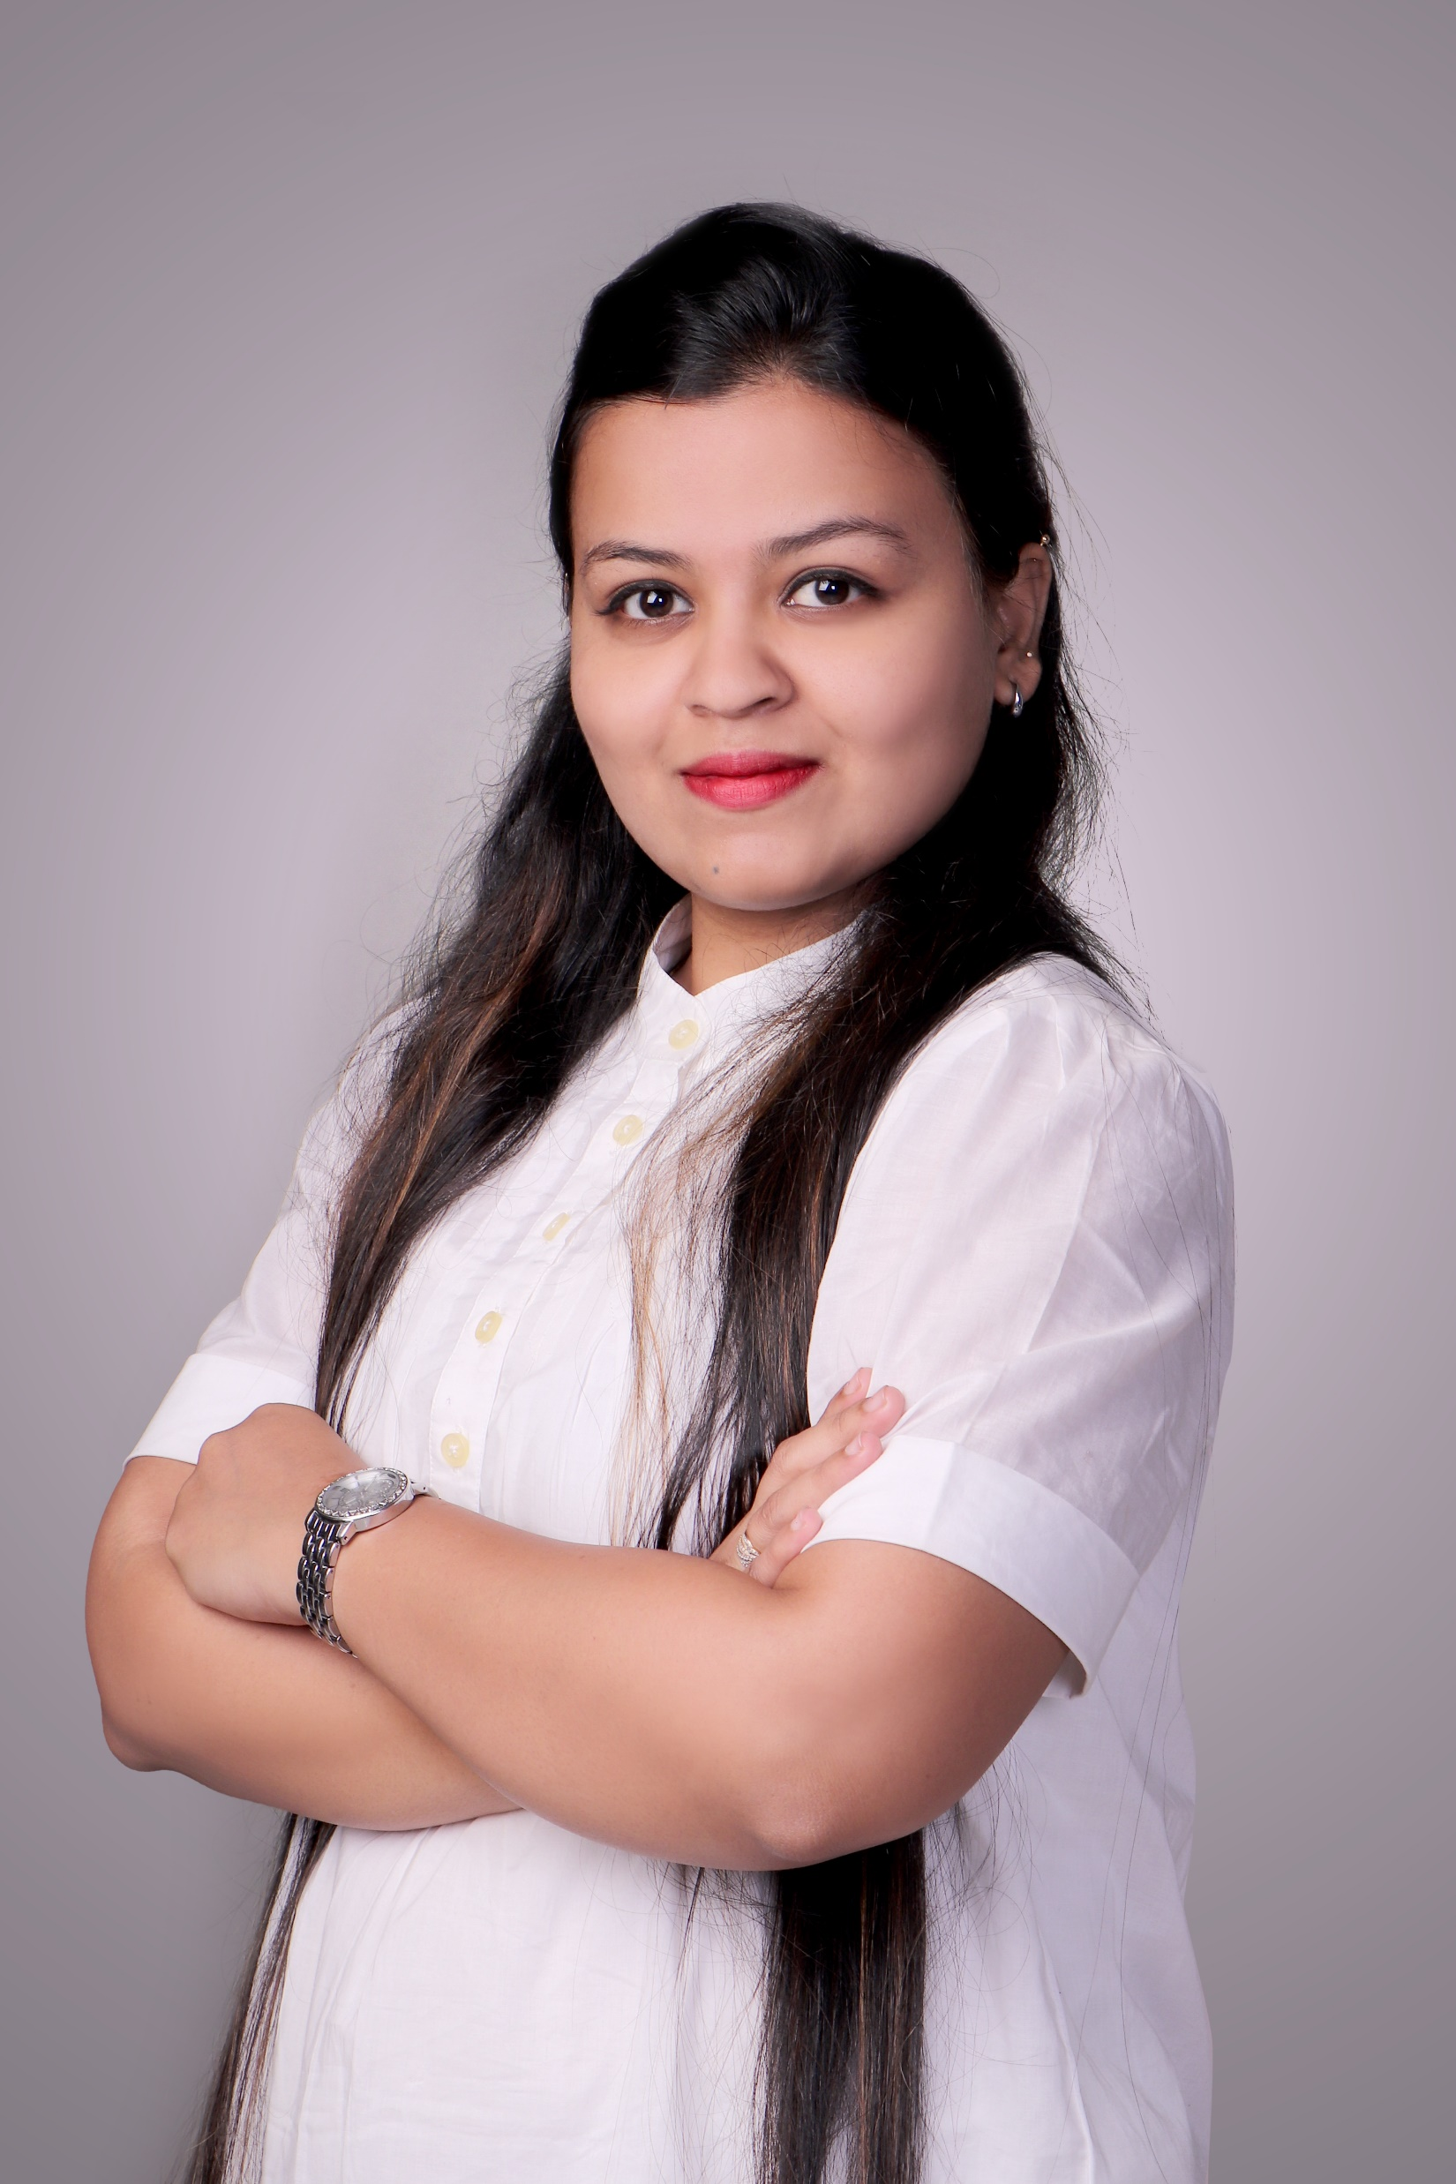

STRENGTH OF OUR ORGANISATION
MARKETING EXPERTS
IMPORT & EXPORT MANAGERS
INTERNATIONAL PURCHASE
& SALES MANAGER
ACCOUNTS & FINANCE EXPERTS
Logistic Incharge & Coordinator (IRAN)
TAX & AUDIT CONSULTANT
The strength of organization depends on our professional & expertise staff. Currently we have 21 expertise staff in 6 different verticals with their professional experience in Marketing & Sales, Accounts, Data analysis, Legal, Exim & Logistics departments to managed & expand business in it’s professional manners. They are playing important role by execution of their various planning & business strategies to expand the organization strength and growth in Bitumen Industry.
LEGAL ADVISOR

Slide 5



OUR VISION & MISSION
We are here, “To give everyone the power to create and achieve the reach instantly in Bitumen Industry, without barriers.”
* Our Visions :
Customer oriented organization with rich numbers.
Market leaders in managing and controlling the Bitumen Industry.
To be the first in innovations in this industry
Holds the strongest company profile in Bitumen Industry
* Our Missions :
Increase Import capacity at all the ports in India.
Increase number of customer base with their reliability.
Create Sales & base across the India.
Increase in number of Joint Ventures.
“Our company has self capital for the business.
(No finance partner, no equity dilution, no debt)”
WHY ONLY OMNIPOTENT & MANAGEMENT ?
Guided by Professional having 19 years of experience in Bitumen Industry.
Well organised private organisation with professional & expert staff with dedicated office & infrastructure for business.
Total market intelligence tracking system for day to day decision on the basis of statistics.
Existing Joint Venture with importers, manufacturers, transporters, warehousing & bulk storage.
Inhouse professionals as Tax Consultant, CHA, Advocate & HR.
Ready Import & Sales strategic plans.
Transport & delivery (Logistics) expertise.
Highly reliable product range.
Good reputation & strong company profile in Bitumen Industry.
Ethical business practices and transparent dealings.
Excellent client servicing.
Competitive & Lowest Prices.

Slide 6

WE TRADE IN :
Import : 60/70 & 80/100
PSU in India : VG10, VG30, VG40
Emulsion as per IS - 8887:1995,
Emulsion as per IS - 8887:2004,
Emulsion as per ASTM – D244.
Blown Bitumen : IS-7021-988 &
IS-1203/1978 ALL GRADES
Micro Surfacing Emulsion : ALL GRADES
Modified Bitumen : CRMB, PMB, NRMB.
WE SEEK FOR :
Partners/JV partners
Suppliers of quality
Bitumen
Warehouse partner
Bitumen customer
Bitumen trader
PROFESSIONAL CONSULTANCY
Bitumen & Bituminous product plant setup end to end solution from identification of land to impart training & making policy with staff on marketing & quality testing.

